Slide 1


BANKING / FINANCIAL SERVICES
Group Name - Miners
Mohemedh Sharaf Sahir
Ye Min Myat
Myat Min Khant
Ro Min Swe
Group 21, C2
Lecturer Name
Assoc. Prof. Ts. Dr. Juhaida Abu Bakar

Slide 2

Background
Rapid growth of digital transactions increases fraud risk.
Traditional fraud detection systems struggle with:
Highly imbalanced datasets (fraud cases are rare).
Evolving fraud patterns that adapt over time.
Real-time detection needs to protect customers.
Rich transaction data (demographics, merchant, device, location) is underutilized.
Financial institutions also need personalization (offers, services, insights) to build trust and loyalty.

Slide 3


Problem Statement
Current fraud detection and personalization methods are limited.
Credit card dataset → highlights the imbalance problem in fraud detection.
Bank transaction dataset → offers richer features, but conventional methods fail to fully leverage them.
Our project applies 4 data mining techniques to solve these gaps:
Market Basket Analysis – find patterns in transaction behavior.
Recommender Systems – suggest personalized banking services.
Anomaly Detection – identify suspicious or fraudulent transactions.
Cluestering – group similar transactions to spot hidden patterns and emerging fraud trends.
Without these, banks risk fraud losses, inefficiency, and customer dissatisfaction.

Slide 4

Objectives
To gather and preprocess the credit card transaction dataset and the bank transaction dataset by merging relevant attributes, handling missing values, addressing data imbalance, and preparing the data for recommendation and fraud detection tasks.
To construct a comprehensive data mining pipeline in the financial domain, applying techniques such as fraud detection (anomaly detection, classification models) and recommender systems (collaborative filtering, content-based, and hybrid approaches) to detect fraudulent transactions and provide personalized service recommendations.
To evaluate the performance of the models using appropriate metrics (e.g., precision, recall, F1-score, ROC-AUC for fraud detection; and RMSE and MAE for recommender systems) and to construct a dashboard that visualizes both fraud detection alerts and recommendation insights for improved decision-making.

Slide 5

Data Description
Dataset 1: creditcard.csv
Shape: 284,807 rows × 31 columns
Columns:
Time, Amount, Class
28 anonymized numerical features (V1–V28) from PCA transformation.
Target: Class → Fraud indicator (0 = Legit, 1 = Fraud).
Notes:
Very well-known Kaggle dataset for fraud detection.
Highly imbalanced (fraud cases ≪ normal cases).
No missing values.
Amount is in actual currency units, while other features are scaled/anonymized.
Dataset 2: Bank Transactions
Shape: 200,000 rows × 24 columns
Columns:
Customer details: ID, Name, Gender, Age, State, City, Account_Type, Contact, Email
Transaction info: ID, Date, Time, Amount, Type, Merchant_ID, Category, Device, Device_Type, Location, Currency
Banking details: Branch, Account_Balance
Target: Is_Fraud → (0 = Legit, 1 = Fraud)
Notes:
Rich dataset with categorical + numerical + text features
More realistic → includes customer & merchant context
No missing values

Slide 6
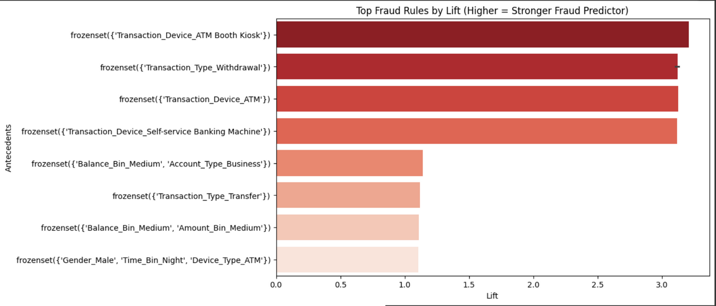
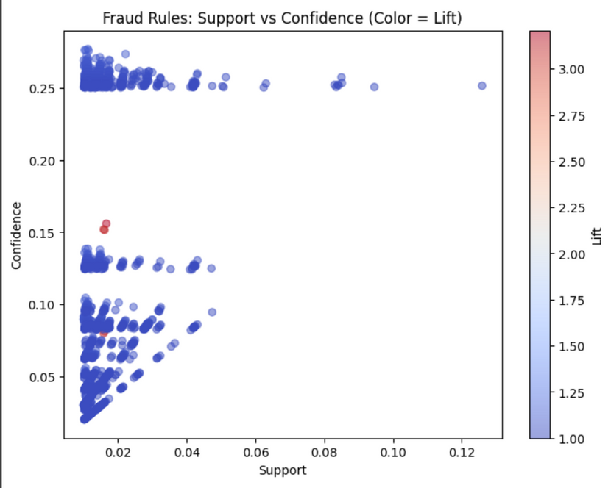
Market Basket Analysis
Results & Analysis
High-risk fraud patterns:
Withdrawals at ATM Booths / Self-Service Machines (Lift ~3).
Withdrawals in general strongly linked to fraud.
Moderate risk: Male + Nighttime withdrawals, Medium-balance business accounts.
Fraud is driven more by transaction type & device than demographics.
Method & Modelling
Cleaned & simplified data (drop IDs, keep State, bin balances & amounts, add time-of-day bins).
Handled fraud imbalance with hybrid balancing.
Applied FP-Growth MBA to find co-occurrence patterns.
Focused only on rules where consequent = Fraud.

Slide 7

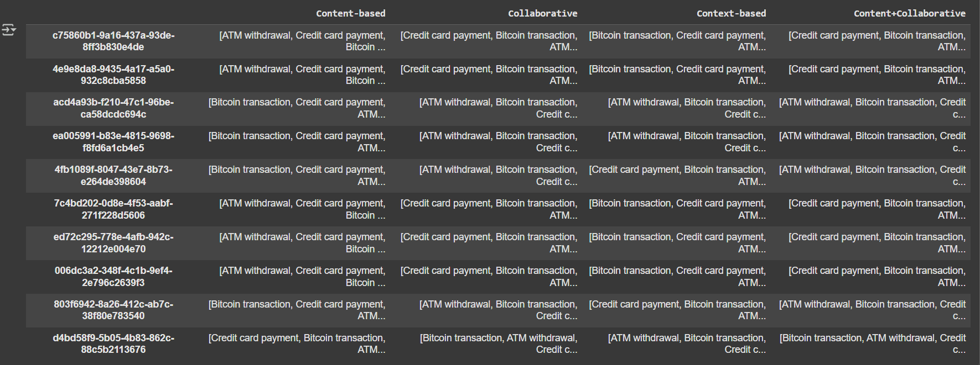
Recommender Systems
Method & Modelling
Dataset: Bank Transaction data (~200k rows), non-fraud transactions only.Models: Content-based (TF-IDF), Collaborative (user-item cosine similarity), Context-based (one-hot encoding of contextual features), Content+Collaborative Hybrid.Evaluation: Top-5 recommendations manually inspected for sample users.
Results & Analysis
Content-based: recommends transactions similar in description.Collaborative: captures patterns from similar users; cold-start issues for new users.Context-based: personalizes recommendations based on user situation.Content+Collaborative: balances item similarity and user behavior, improves recommendation coverage

Slide 8
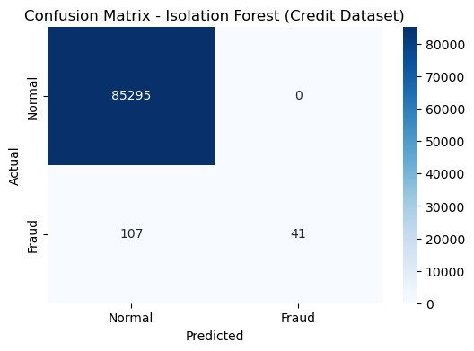
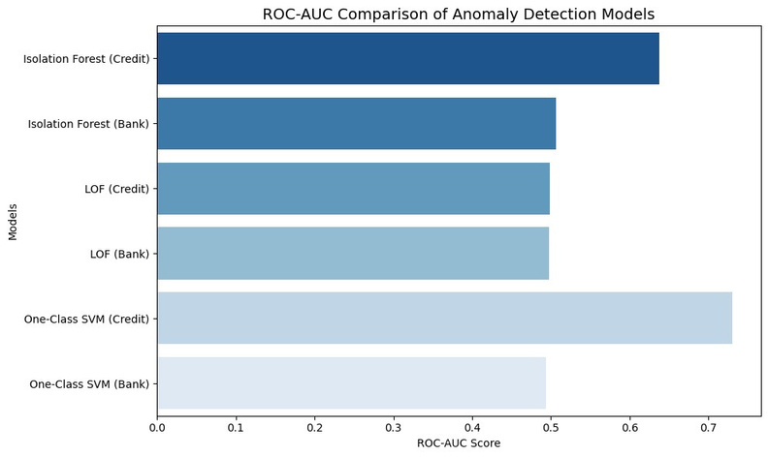
Anomaly detection
Methods and Modelling
Cleaned data (removed duplicates, handled missing values)
Feature engineering (log_amount, ratios, balance changes)
Normalized with RobustScaler
SMOTE oversampling for fraud cases (training only)
Methods Applied
Isolation Forest – tree-based anomaly detection
Local Outlier Factor (LOF) – density-based
One-Class SVM – boundary-based (sampled due to cost)
Results & Findings
Normal transactions → predicted correctly
Fraud transactions → detected 41 out of 148
Missed 107 frauds → challenge of class imbalance
Isolation Forest (Credit): 0.64 ROC-AUC
One-Class SVM (Credit, sampled): 0.73 ROC-AUC, but costly
LOF: ~0.5, close to random guess
Bank dataset: all models weaker overall
Recommendations
Use anomaly detection mainly as an early warning tool to flag unusual transactions in real time.
For stronger fraud detection, especially in bank data, combine anomaly detection with supervised models rather than relying on it alone.

Slide 9


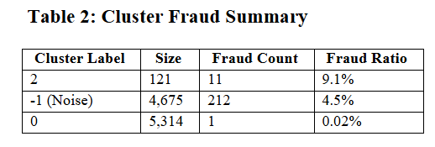
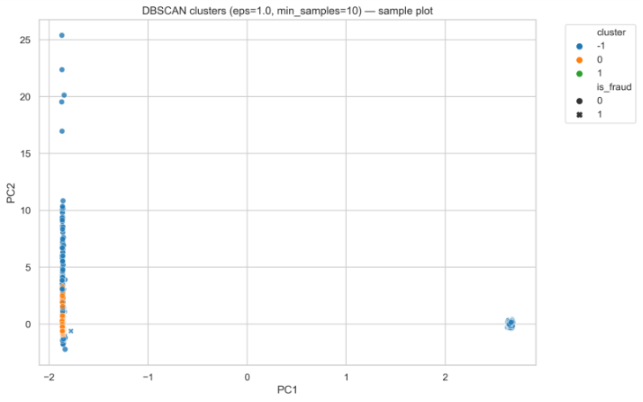
CLUSTERING
1. Dataset Preparation (Preprocessing)
Removed IDs, encoded categorical (Transaction_Type, Device_Type)
Standardized numeric (Amount, Balance), PCA (10 comps)
4. Recommendations
Fraud Alerts → unusual transactions (noise points)
Spending Profiles → cluster-based financial insights
Safe Transaction Score → flag anomalies for verification
Budget Nudges → guide irregular spenders
2. Algorithm Used
DBSCAN (eps=1.0, min_samples=10)
Finds arbitrary clusters + isolates anomalies as noise
3. Results (Key Findings)
2 clusters + 4,675 noise points
Silhouette = 0.61 (good separation)
Fraud distribution:
Cluster 0 → 0.02% fraud (normal spending)
Cluster 2 → 9.1% fraud (suspicious group)
Noise → 4.5% fraud (isolated anomalies)

Slide 10
Conclusion
CLUSTERING
Preprocessed and combined credit card + bank datasets for consistency.
Applied DBSCAN, which formed dense clusters of normal transactions and flagged ~4,675 anomalies as noise.
Fraud cases concentrated in noise (4.5%) and small clusters (up to 9.1%), proving DBSCAN’s strength in anomaly detection.
Insights support fraud alerts, spending profiles, Safe Transaction Scores, and budgeting nudges for users.
Overall, DBSCAN is effective, robust, and more suitable than centroid-based methods for fraud detection.
Market Basket Analysis (MBA)
FP-Growth MBA revealed interpretable fraud rules.
Strongest predictors: ATM withdrawals & self-service devices.
Actionable insight:
Flag suspicious withdrawals in real time.
Prioritize monitoring of ATM/self-service transactions.
Fraud Detection + Recommender System
Explored multiple recommender approaches:
Content-based highlighted transaction similarity but limited to item features.
Collaborative filtering captured user-to-user patterns but struggled with cold starts.
Context-aware improved personalization using external factors like location or device.
Hybrid RS (content + collaborative) balanced relevance and personalization, offering the most reliable results.
Overall, combining fraud detection with hybrid recommendation provides a safer and more personalized system, ensuring users receive trustworthy transaction suggestions.
Anomaly Detection
Isolation Forest gave the best results on the Credit Card dataset.
One-Class SVM showed higher accuracy on smaller samples but was costly.
Bank dataset results were weaker across all methods.
Anomaly detection useful for flagging suspicious transactions.
Should be combined with supervised models & expert knowledge for stronger fraud detection.

Slide 11

THANK YOU

